Slide 1
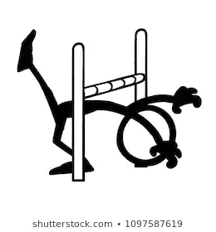
Durham & Chester-Le-Street School Sport Partnership
 | Physical activity Limbo
Tie bells to a skipping rope. Holding the rope high enough for the children to walk under to begin with take it in turns to travel under the rope without making the bells ring. After each child ( or parent ) has had a go begin to lower the rope. See who can travel under the rope without ringing the bell at all different heights. Investigate all the different ways you can travel under the rope.

