Slide 1
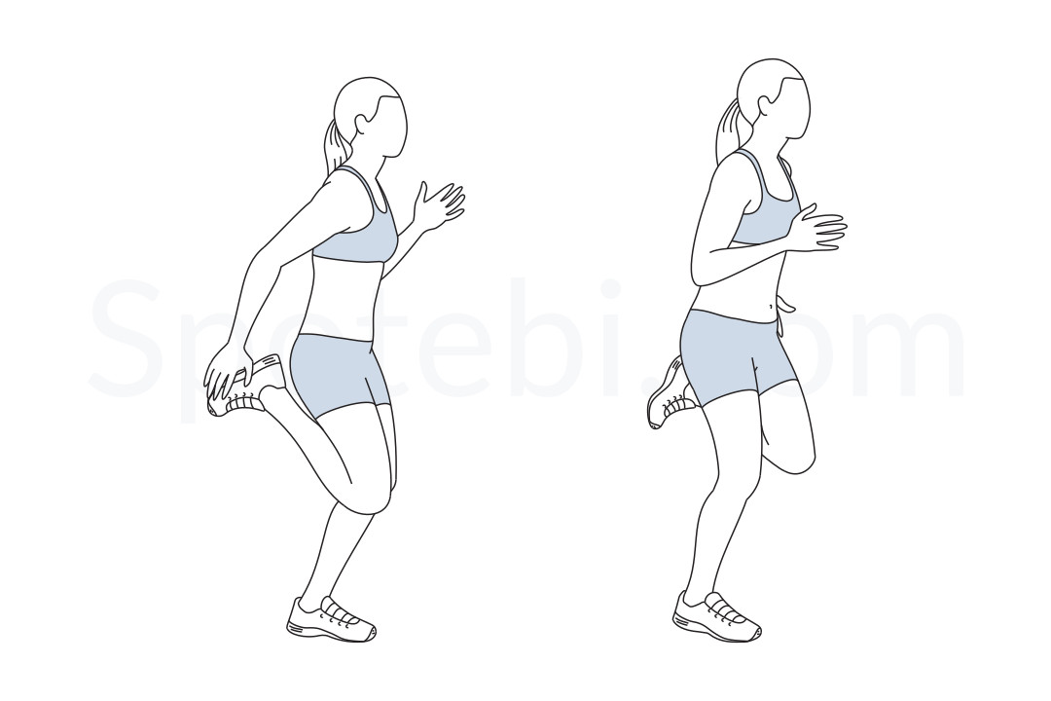
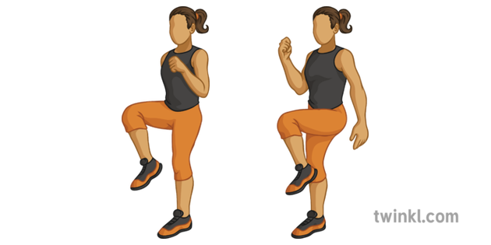
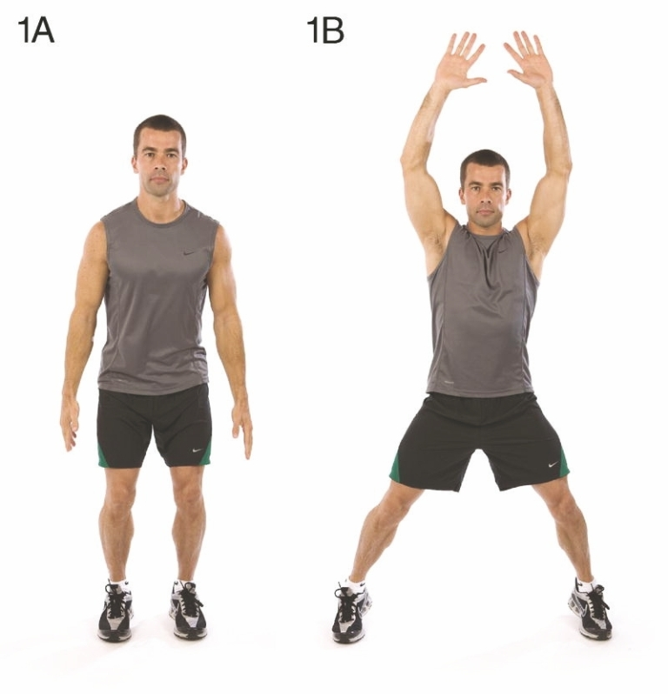
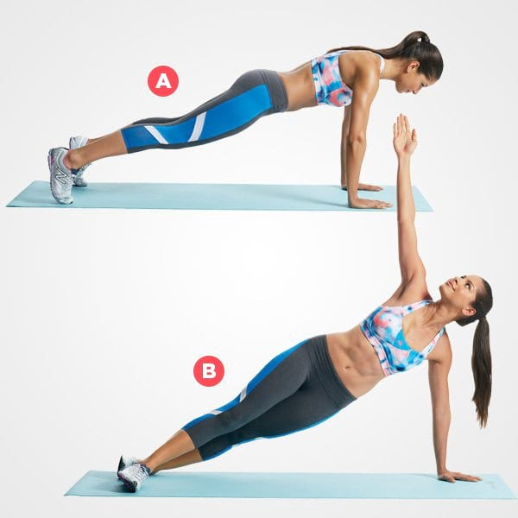
Durham and Chester-Le-Street SSP
Maiden Castle
The Graham Sports Centre, Durham University Stockton Road DH1 3SE
Fitness Moves

Slide 2
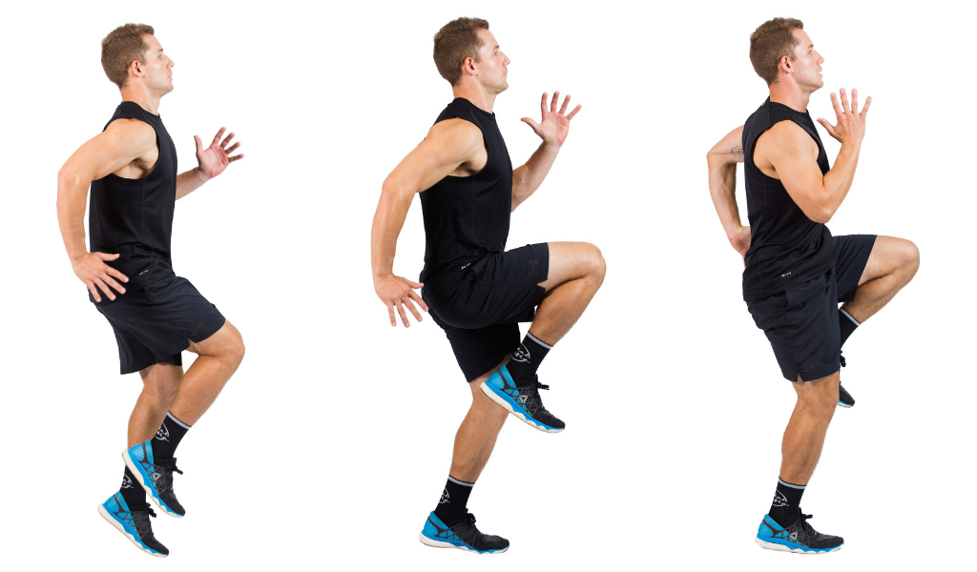
Durham and Chester-Le-Street SSP
Maiden Castle
The Graham Sports Centre, Durham University Stockton Road DH1 3SE
On the Spot Sprints
Pick a spot to focus on in front of you to help your balance and posture
Drive your arms forwards and backwards (opposite arm to knee)
Land softly on the balls of your feet
Options:
March fast instead of sprinting

Slide 3
Durham and Chester-Le-Street SSP
Maiden Castle
The Graham Sports Centre, Durham University Stockton Road DH1 3SE
High Knees
Pick a spot to focus in front of you to help your balance and posture
Ensure your arms are moving forwards and backwards (opposite arm to knee)
Land softly on the balls of your feet
Knee should be at 90-degree angle
Engage your abdominal muscles and control your breathing
Options:
March fast instead of high knee runs, keep it low impact (one foot is always on the floor)

Slide 4
Durham and Chester-Le-Street SSP
Maiden Castle
The Graham Sports Centre, Durham University Stockton Road DH1 3SE
Butt Kicks
Pick a spot to focus on in front of you to help your balance and posture
Ensure your arms are moving forwards and backwards (opposite arm to leg)
Land softly on the balls of your feet
Kick your heels up behind you.
Engage your abdominal muscles and control your breathing
Options:
Slow butt kicks instead of fast butt kicks, keep it low impact (one foot is always on the floor)

Slide 5
Durham and Chester-Le-Street SSP
Maiden Castle
The Graham Sports Centre, Durham University Stockton Road DH1 3SE
Jumping Jacks
Pick a spot to focus on in front of you to help your balance and posture
Ensure you try and keep your arms as strong as you can throughout the jumping jacks
Land softly on the balls of your feet in picture 1A and 1B
Engage your abdominal muscles and control your breathing
Options:
Half Jacks- Keep at least one foot always on the floor (no jumping) one foot taps out to the side and is brought back into the centre and then the other foot taps out (repeat).

Slide 6
Durham and Chester-Le-Street SSP
Maiden Castle
The Graham Sports Centre, Durham University Stockton Road DH1 3SE
Plank Hold
Hold a still position
Full forearm on the floor (Picture 1)
Hands fully flat on the floor with arms straight with weight over the hands (shoulder in line with hands) (Picture 2)
Ensure you do not arch your back or push your bottom upwards
Engage your abdominal muscles and control your breathing

Slide 7
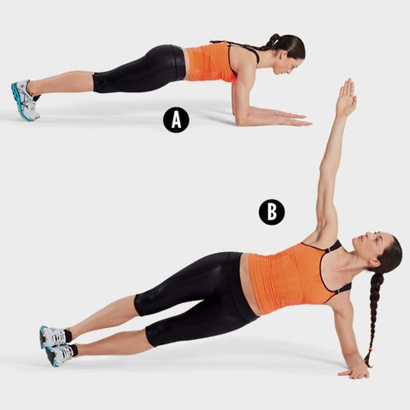
Durham and Chester-Le-Street SSP
Maiden Castle
The Graham Sports Centre, Durham University Stockton Road DH1 3SE
Plank Rotation
Ensure you follow all of the coaching points for the plank hold position
Slow controlled movement
Ensure you do not over rotate by the midline of the body
Options:
Select the picture that suits your ability

Slide 8
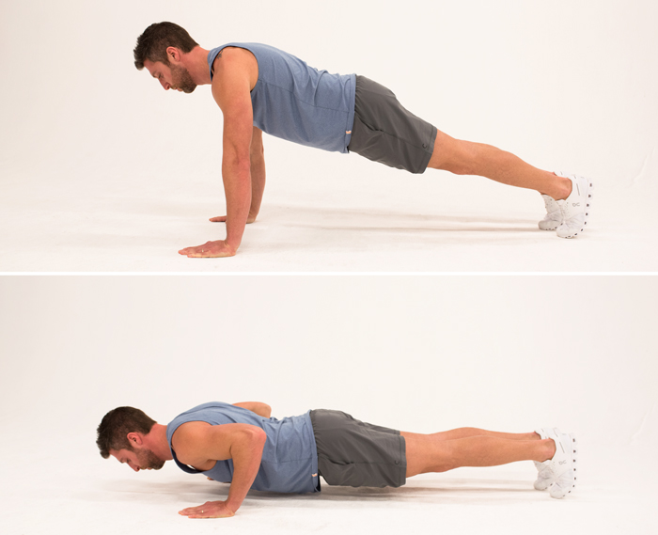
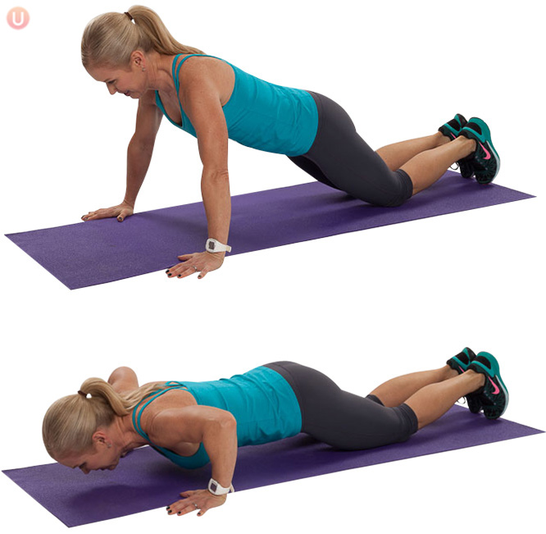
Durham and Chester-Le-Street SSP
Maiden Castle
The Graham Sports Centre, Durham University Stockton Road DH1 3SE
Press Up
Ensure you follow all of the coaching points for the plank hold position
Ensure your full hand is always on the floor
Breath out on way up phase then breath in on way down
Ensure you do not over rotate by the midline of the body
Options:
Select the picture that suits your ability

Slide 9
Durham and Chester-Le-Street SSP
Maiden Castle
The Graham Sports Centre, Durham University Stockton Road DH1 3SE
Mountain Climbers
Ensure you follow all of the coaching points for the plank hold position
Ensure your full hand is always on the floor
Drive your knees one at a time through to chest
Keep your upper body still.
Options:
Slow the speed at which you move the knees towards the chest

Slide 10
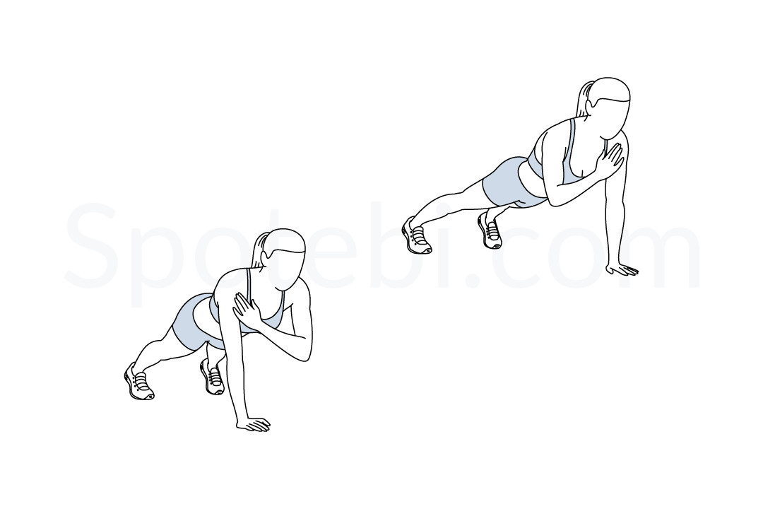
Durham and Chester-Le-Street SSP
Maiden Castle
The Graham Sports Centre, Durham University Stockton Road DH1 3SE
Shoulder Taps
Ensure you follow all of the coaching points for the plank hold position
Slow controlled movement
Ensure your supporting hand is fully flat on the floor
Opposite hand to opposite shoulder
Options:
Slow the movements down and refer back to plank hold position instead of lifting one hand off the floor

Slide 11
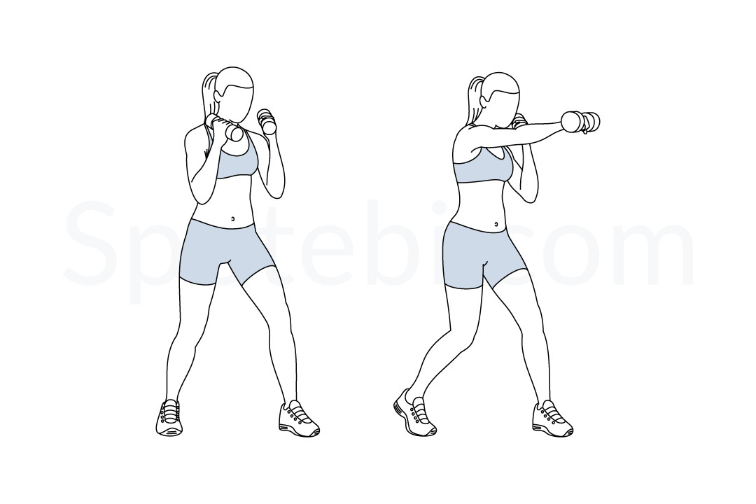
Durham and Chester-Le-Street SSP
Maiden Castle
The Graham Sports Centre, Durham University Stockton Road DH1 3SE
Standing Punches
Hands stay at shoulder height (you can hold small light weights or a can of beans in either hand)
Twist at hips to move shoulders forward
Options:
Slow the speed of the punches down
Remove the weight or cans
Increase the quickness of your punches

Slide 12
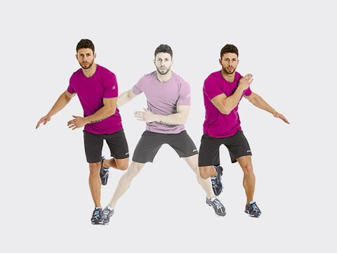
Durham and Chester-Le-Street SSP
Maiden Castle
The Graham Sports Centre, Durham University Stockton Road DH1 3SE
Side to Side Jumps
Land softly on the balls of the feet
Engage the abdominal muscles for balance
When jumping to the side opposite arm is out for support
Look forwards and don’t look down
Options:
Slow the jumps down
Take the jump out and step side to side holding the still position
Increase the distance from side to side when you jump
Hold the still position for at least 2 seconds before you take your next jump (good for core stability)

