Slide 1
Durham & Chester-Le-Street School Sport Partnership
mini decathalon challenge especially for Nursery and Reception children.
Activity Card 1 | Activity Card 2 | Activity Card 3
Sprint | Long jump | Shot putt
Equipment needed Stop watch or any timer Start line and finish line. | Equipment needed A start line and a measuring tape | Equipment needed A ball that can fit in your hand
Instructions The decathalon has 100 meter sprint. We can have a 10 meter sprint. Mark out the course in the garden. Get ready, set and go ………… Can you beat your Mums / Dads / Brothers or Sisters time? | Instructions Stand with two feet behind the starting line. Swing your arms backwards and forwards and bend your knees a little bit. When you are ready jump forwards as far as you can. Don’t fall over though! Look at how far you jumped…… Is it really far? Have another go and see if you can beat your record. | Instructions Stand at your starting line again but this time stand sideways. Hold the ball in your throwing hand and make a big star shape with your body. Put the ball right next to your neck…. It might feel cold. Lean away from the line and push the ball away from your neck and as far away from the starting line as possible. I bet it flies through the air!!!!

Slide 2
Durham & Chester-Le-Street School Sport Partnership
mini decathalon challenge especially for Nursery and Reception children
Activity Card 4 | Activity Card 5 | Activity Card 6
High Jump | Middle distance run | Hurdles
Equipment needed A skipping rope | Equipment needed Stop watch or any timer Start line and finish line and a track to run around | Equipment needed 5 large teddies A start line and a finish line A stop watch or timer
Instructions This one is a tricky one. We don’t want anyone getting hurt so go very carefully. Ask someone to hold a skipping rope up just off the ground for you and see if you can jump over it. Think of all the ways you can jump. Remember to land on your feet and bend your knees. The athletes who do this in competitions have a soft mat to land on… we are not so lucky. Gradually get higher and higher. | Instructions Set up a course in your safe space…. A back garden, a yard or out on the path if your parents say its safe and they can take you. Jog around the safe space for 2 minutes without stopping. You will feel out of breath and want to give up, but keep going. How many times did you jog around your safe space track? | Instructions Put a teddy out on the grass or floor somewhere that has space. Do three giant steps in a straight line then put another teddy on the ground. Do the same for all five of your teddies. Now see how quickly you can hurdle (jump) over the teddies when you run from the start to the finish line.

Slide 3
Durham & Chester-Le-Street School Sport Partnership
mini decathalon challenge especially for Nursery and Reception children
Activity Card 7 | Activity Card 8 | Activity Card 9
Discuss | Pole vault | Javelin
Equipment needed A frizbee or something flat like a rubber floor spot or soft cone A start line A measuring tape | Equipment needed An adult to help you A starting line | Equipment needed A soft ball that you can hold in your hand A starting line A measuring tape
Instructions Stand at your starting line again like you did for the shot putt so you are sideways, Hold the discuss in your throwing hand and make a big star shape with your body. Pull your throwing arm right back and swing it forwards, letting go of the discuss. This is a tricky one so be careful. How far did it fly? | Instructions Real pole vault athletes have a really big pole that helps them jump really high in the air and a soft mat to land on. We cant do that but we can Mummy’s od Daddy’s hand, run up the starting line and see how high you can jump when they are holding your hand. Measure this by saying high, very high, or up in the clouds high. | Instructions Hold a small ball in your hand right up above your head. Run up to the line and throw it as far as you can. Measure how far you can make the ball go. You can do this by putting a cone or marker down where it lands.

Slide 4
Durham & Chester-Le-Street School Sport Partnership
Infant Agility Cards
Activity Card 10
Long distance run
Equipment needed Stop watch or any timer Start line and finish line and a track to run around
Instructions Set up a course in your safe space…. A back garden, a yard or out on the path if your parents say its safe and they can take you. Jog very slowly around the safe space for 5 minutes without stopping. You will feel even more out of breath than the last run and want to give up, but keep going. You can do it! How many times did you jog around your safe space track?
How did you do? Do you deserve a gold, silver or bronze medal? Look on the next page.

Slide 5
Durham & Chester-Le-Street School Sport Partnership
Infant Agility Cards
Well done.
You were amazing
in all events.

Slide 6
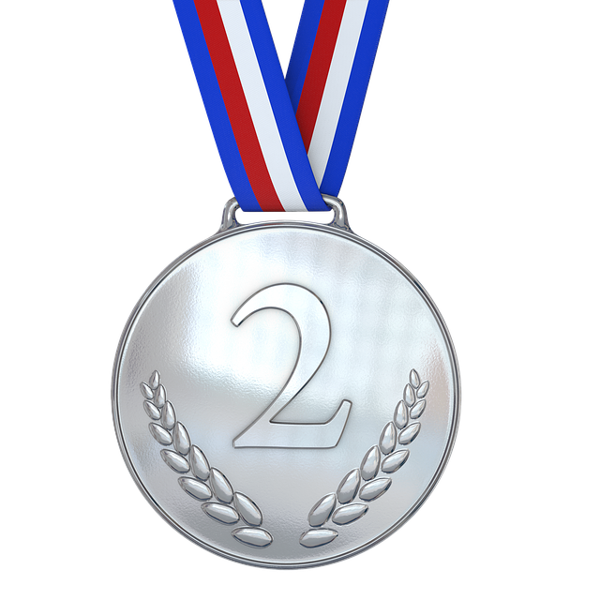
Durham & Chester-Le-Street School Sport Partnership
Infant Agility Cards
Great effort.
You are a superstar for giving it a go.

Slide 7
Durham & Chester-Le-Street School Sport Partnership
Infant Agility Cards
Fantastic.
You have earned a bronze medal for trying really hard.

