Slide 1
We all know the benefits of being physically active . When times are tough and it is difficult to get outdoors, it can be quite tricky to come up with ideas to keep the children occupied and active. With modern technology, there are numerous websites available to support physical activity at home; not just for children, but for the whole family. Most activities only take around 5-30 minutes to complete, so it can fit easily into the day. Here are some ideas and resources we think you might find useful placed in a weekly activity timetable. You can adapt the timetable to suit your own needs! If you have any further activities you recommend, please let us know and we can share them with everyone else.
Key Stage 1
(Year 1 & 2)
ACTIVE AT HOME
Check out our social media channels and tag us in any of your activities
Facebook - @DurhamClsSSP
https://www.facebook.com/DurhamClsSSP/
Twitter - @DurhamCLS_SSP
https://twitter.com/DurhamCLS_SSP

Slide 2
Durham & CLS School Games – Physical Activity Timetable Week 5 – Key Stage 1 (Year 1 & 2)
 | MONDAY | TUESDAY | WEDNESDAY | THURSDAY | FRIDAY
PHYSICAL ACTIVITY | Take part in the Frozen or Aladdin physical activity challenge while you watch a film. Look at slides 3 & 4 for instructions. | Toy Story 4. Find Forky. Take part in the game of finding Forky. Follow this link for instructions. https://www.nhs.uk/10-minute-shake-up/shake-ups/find-forky | Lion King. Pumbaa’s Hippo Hops. Take part in the game of jumping, hoping and leaping. Follow this link for instructions. https://www.nhs.uk/10-minute-shake-up/shake-ups/pumbaas-hippo-hops | Can you take part in the dice workout? All you need is a dice and some space! Look at slide 11 for instructions. | Can you make up a physical activity and take part in it? Get someone at home to take part with you! Remember you know when you have been active if your heart is beating faster, your breathing is faster and deeper, and your head feels warm to touch! Good luck.
SCHOOL GAMES VALUES ACTIVITY | Self Belief Fill in the self belief activity sheet on slide 5. Believing and knowing you are good at things gives you the self belief everyone need’s to be successful in sport. | Passion Fill in the blank spaces on the activity sheet on slide 7 with words or pictures to show what passion in sport is. | Honesty Play the honesty dice game. See slide 9 for the rules. | Determination Can you take part in the building block challenge on slide 12. Show your determination to build the biggest tower. | Team Work Can you show good teamwork at home by working together to tidy up a room. Good teamwork is the best when you all have your own important roles in the task.
CHALLENGE ACTIVITY | Balance Dice. Can you challenge someone at home to this test of balance activity. See slide 6 for instructions. | Have a game of Dragon’s Nest against someone at home. See slide 8 for instructions. | Have a go at the build and destroy game. You will need to use your imagination to build a castle and have good aim to knock it down. See slide 10 for instructions. | Have a go at Not in my back yard challenge!! Use different types of throwing and try and throw into spaces. See slide 13 for instructions. | Have a go at Jumping Numbers. Challenge someone at home. See slide 14 for instructions.

Slide 5
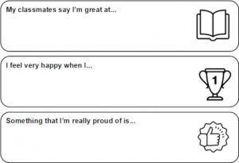

Slide 6
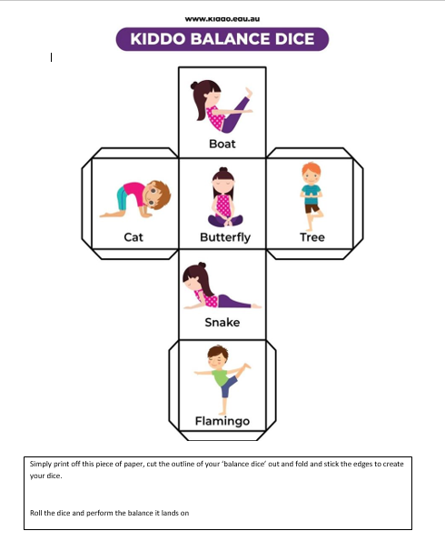

Slide 7
PASSION

Slide 8
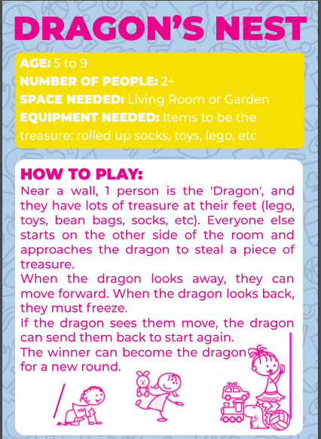

Slide 9
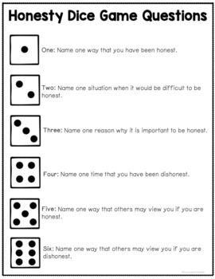

Slide 11
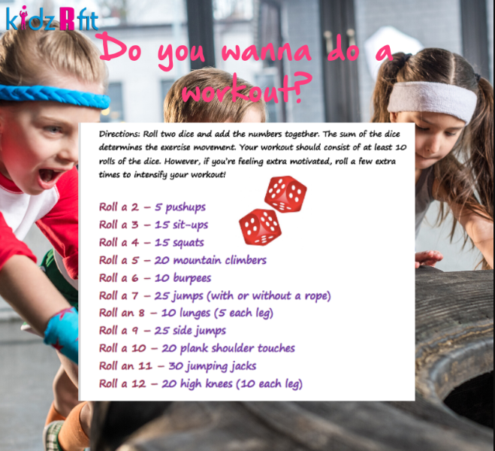

Slide 12
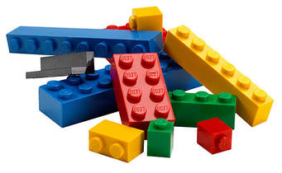
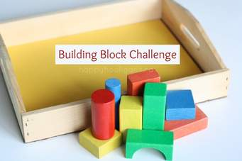
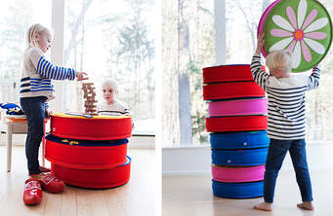
DETERMINATION
Can you show determination by building the biggest tower you can, you could even make it a competition between you and someone at home!! You can use lego, building blocks, cuddly toys, cushions, etc.

