Slide 1
We all know the benefits of being physically active . When times are tough and it is difficult to get outdoors, it can be quite tricky to come up with ideas to keep the children occupied and active. With modern technology, there are numerous websites available to support physical activity at home; not just for children, but for the whole family. Most activities only take around 5-30 minutes to complete, so it can fit easily into the day. Here are some ideas and resources we think you might find useful placed in a weekly activity timetable. You can adapt the timetable to suit your own needs! If you have any further activities you recommend, please let us know and we can share them with everyone else.
Key Stage 1
(Year 1 & 2)
ACTIVE AT HOME
Check out our social media channels and tag us in any of your activities
Facebook - @DurhamClsSSP
https://www.facebook.com/DurhamClsSSP/
Twitter - @DurhamCLS_SSP
https://twitter.com/DurhamCLS_SSP

Slide 2
Durham & CLS School Games – Physical Activity Timetable Week 4 – Key Stage 1 (Year 1 & 2)
 | MONDAY | TUESDAY | WEDNESDAY | THURSDAY | FRIDAY
PHYSICAL ACTIVITY | Follow a Leanne fitness session from our SSP website Newsfeed https://durhamcls-ssp.co.uk/ 🌟 KS1 WORKOUT 🦍 Gorilla Run 🐸 Froggies 🐰 Bunnyhop 🐵 Monkey Jumps 🐍 Cobra 🦖 T Rex | Jumping obstacle course Can you make your own jumping obstacle course. Look at slide 5 for instructions. | Air hockey. Can you play air hockey against someone in your house? Look at slide 7 for instructions. | Follow a Leanne fun fitness session from our SSP website Newsfeed. https://durhamcls-ssp.co.uk/ 💥 This is by far my favourite workout, ideal for KS1 & KS2 🦘 We’ve got kangaroo jumps, donkey kicks and loads more fun!! 👍 Give it a go!!! | Do the Dash target throw. Have a go, remember to use an underarm throw. See slide 11 for instructions.
SCHOOL GAMES VALUES ACTIVITY | Self Belief Can you try Nelly’s number machine challenge Level 2. You must show that you believe in your maths skills, don’t give up!! See slide 3 for instructions. | Passion Watch the short film on why children love sport. Could you make a video about why you love sport? Click Here for Video | Honesty Be in charge of a score card in today’s air hockey challenge. Can you be honest and keep the correct score, even if it means that you loose the game. | Determination Can you achieve getting a determination certificate today in the physical activity and challenge activity? Your parent/guardian will tell you if you achieved determination today. See slide 9 for the determination certificate. | Team Work Can you and your household balance as many cuddly toys on top of each toy, you will need to work as a team to try and balance as many toys on top of each toy without them falling.
CHALLENGE ACTIVITY | Save the bears. Can you challenge someone at home in the save the bear challenge? Look at slide 4 for instructions. | Do the Dash speed bounce. Have a go and challenge someone at home. See slide 6 for instructions. | Can you challenge someone at home to the jumping dice challenge? See slide 8 for instructions. | Challenge someone at home to the balloon keepy up challenge. See slide 10 for instructions. | Tidy your room challenge. Can you challenge someone at home in this challenge. Click here for Video

Slide 3
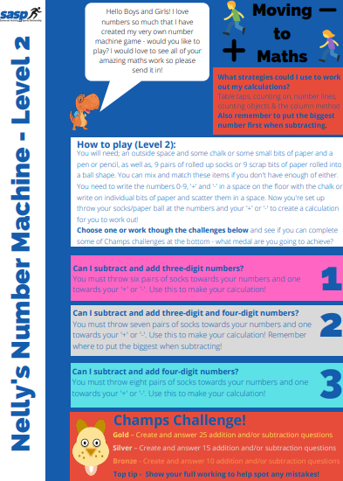

Slide 5
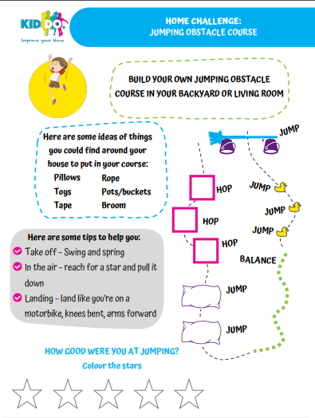

Slide 6
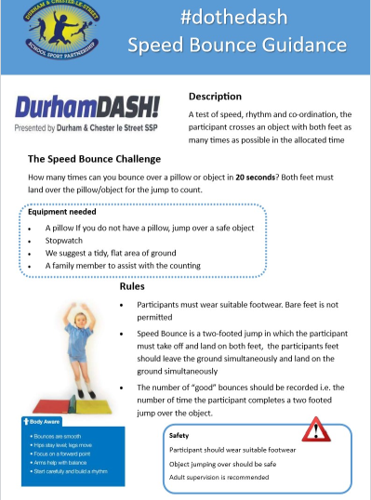

Slide 7
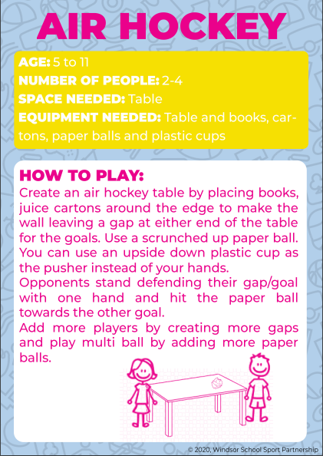

Slide 10
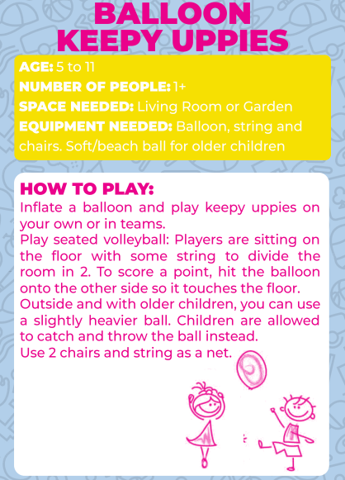

Slide 11
