Slide 1
We all know the benefits of being physically active . When times are tough and it is difficult to get outdoors, it can be quite tricky to come up with ideas to keep the children occupied and active. With modern technology, there are numerous websites available to support physical activity at home; not just for children, but for the whole family. Most activities only take around 5-30 minutes to complete, so it can fit easily into the day. Here are some ideas and resources we think you might find useful placed in a weekly activity timetable. You can adapt the timetable to suit your own needs! If you have any further activities you recommend, please let us know and we can share them with everyone else.
Key Stage 1
(Year 1 & 2)
ACTIVE AT HOME
Check out our social media channels and tag us in any of your activities
Facebook - @DurhamClsSSP
https://www.facebook.com/DurhamClsSSP/
Twitter - @DurhamCLS_SSP
https://twitter.com/DurhamCLS_SSP

Slide 2
Durham & CLS School Games – Physical Activity Timetable Week 3 – Key Stage 1 (Year 1 & 2)
 | MONDAY | TUESDAY | WEDNESDAY | THURSDAY | FRIDAY
PHYSICAL ACTIVITY | Can you try some of the bouncing and skipping activities on slide 3? | Follow this cool hip hop routine Click here for video | Can you build a sheet fort? Look at slide 5 for instructions. | Follow SSP Coach Gemma’s Teddy Bear Twist Click here for Video | Can you play sock bowls? See slide 8 for instructions.
SCHOOL GAMES VALUES ACTIVITY | Self Belief Can you try Nelly’s number machine challenge. You must show that you believe in your maths skills, don’t give up!! See slide 4 for instructions. | Passion Can you pretend to be a TV presenter and introduce your favourite sport to the viewers! Think about why you love the sport so much, show your passion in your words and voice. | Honesty Watch the video on why honesty is so important. Can you talk about times when people might show honesty in sport or in your PE lessons? Click here for Video | Respect The word on the street today is respect! Watch the video and then try and show respect to everyone today at home. Can you tell people in your house what respect is and why it is so important? Click here for Video | Team Work Can you and your household take part in the add it on activity? You will all have to show team work, encouraging each other to keep going and linking your moves together. See slide 9 for your instructions.
CHALLENGE ACTIVITY | Can you challenge Darren our coach in the step up challenge? Click here for Video | Can you challenge Ross our coach in the tuck in tuck out challenge? Click here for Video | Can you challenge someone at home in the ‘Closest to the Wall’ challenge on slide 6? | Can you cross the river without falling in? See slide 7 for instructions. | Can you challenge someone at home in toy hide and seek? See slide 10 for instructions.

Slide 7
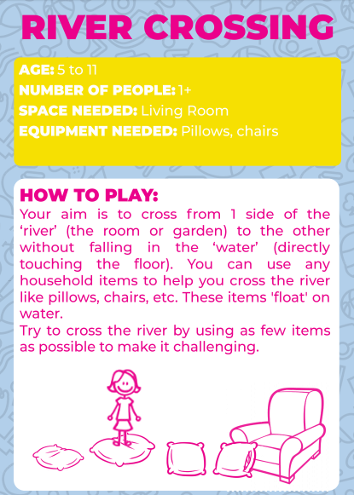

Slide 9
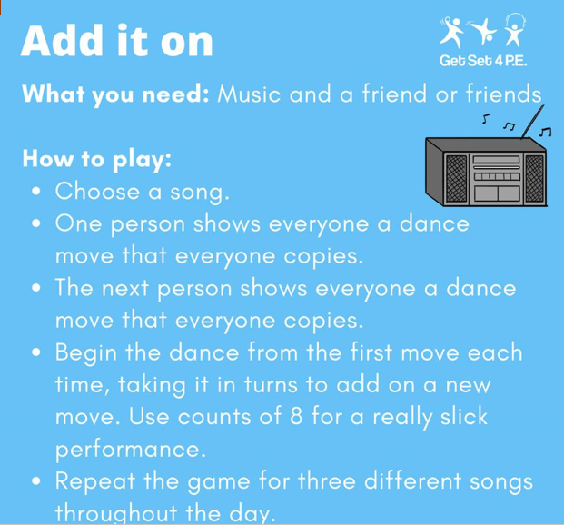

Slide 10
