Slide 1
We all know the benefits of being physically active . When times are tough and it is difficult to get outdoors, it can be quite tricky to come up with ideas to keep the children occupied and active. With modern technology, there are numerous websites available to support physical activity at home; not just for children, but for the whole family. Most activities only take around 5-30 minutes to complete, so it can fit easily into the day. Here are some ideas and resources we think you might find useful placed in a weekly activity timetable. You can adapt the timetable to suit your own needs! If you have any further activities you recommend, please let us know and we can share them with everyone else.
Key Stage 1
(Year 1 & 2)
ACTIVE AT HOME
Check out our social media channels and tag us in any of your activities
Facebook - @DurhamClsSSP
https://www.facebook.com/DurhamClsSSP/
Twitter - @DurhamCLS_SSP
https://twitter.com/DurhamCLS_SSP

Slide 2
Durham & CLS School Games – Physical Activity Timetable Week 1 – Key Stage 1 (Year 1 & 2)
 | MONDAY | TUESDAY | WEDNESDAY | THURSDAY | FRIDAY
PHYSICAL ACTIVITY | Test your reactions, can you tell a family member what reactions are? See example on slide 3 | Follow SSP Coach Gemma Smith’s Hot Hot Hot (Football Fever) dance routine. Click here for video | Test your balance. Take part in the balance challenges. See example on slide 6 | Follow SSP Coach Gemma Smith’s Dance Party Freeze Game. Click here for video | Be active for 30 minutes using transport. For example Balance Bike, Scooter, Bike, Skateboard
SCHOOL GAMES VALUES ACTIVITY | Self belief Try the home challenge sheet. Don’t give up with the challenges believe in yourself!! Complete challenges 1-9. See slide 4 | Passion Design a picture, report, video, etc. to show passion in sport. Can you play a game at home and show your passion throughout it. Simple races against your family are a good way to show your passion! | Respect Can you make up a game with your family and make up simple rules to follow. Follow the rules showing respect for them. | Determination Try to complete a simple puzzle. See example on slide 8 | Team Work Play a new game with your family. See example on slide 10
CHALLENGE ACTIVITY | Try challenging a family member to the stairs challenge! Who can do the most step ups in 30 seconds. Click here for challenge video | Try Activity 1 – The 10m sprint challenge. See challenge card on slide 5 | Try Activity 2 – The Long Jump Challenge. See challenge card on slide 7 | Play Pirates. Challenge someone at home. See example on slide 9 | Star Jump Challenge Challenge someone at home. See example on slide 11

Slide 4
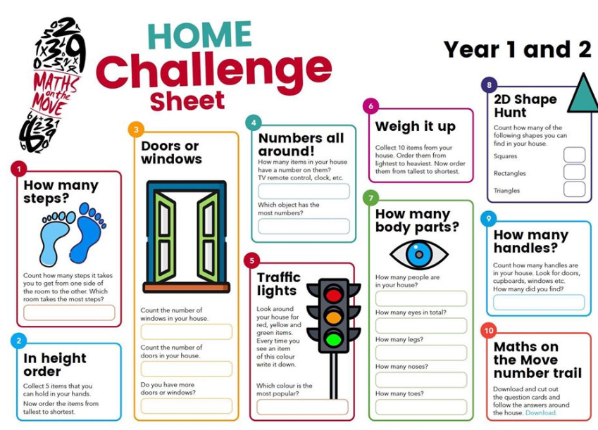

Slide 5
Durham & Chester-Le-Street School Sport Partnership
Challenges especially for Nursery and Reception children.
Activity Card 1
Sprint
Equipment needed Stop watch or any timer Start line and finish line.
Instructions This challenge involves a 10 meter sprint. Mark out the course in the garden, or at a safe open space (park/field) etc. Get ready, set and go ………… Can you beat your Mums / Dads / Brothers or Sisters time?

Slide 7
Durham & Chester-Le-Street School Sport Partnership
Challenges especially for Nursery and Reception children.
Activity Card 2
Long jump
Equipment needed A start line and a measuring tape
Instructions Stand with two feet behind the starting line. Swing your arms backwards and forwards and bend your knees a little bit. When you are ready jump forwards as far as you can. Don’t fall over though! Look at how far you jumped…… Is it really far? Have another go and see if you can beat your record.

Slide 8
Puzzle Example (print two copies of the picture below, cut one of the pictures up into big pieces and ask your son/daughter to put the picture back together) Extension activity-hide the puzzle pieces around a room

Slide 10
Example Game

Slide 11
