Slide 1
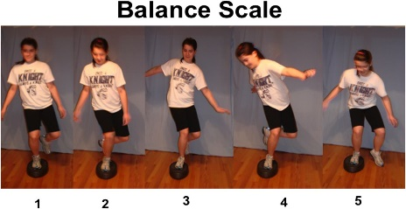
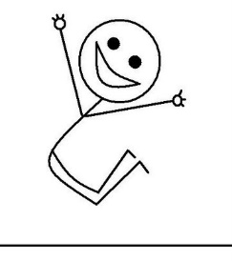
Durham & Chester-Le-Street School Sport Partnership
Infant Agility Cards
Activity Card 1 | Activity Card 2 | Activity Card 3
Thrower | Balancer | Bouncer
Equipment needed Rubber lines for starting line. Lightweight ball. Cones Measuring tape | Equipment needed 1 stop watch or anything to time the activity 1 spot | Equipment needed Large teddy to make a speed bounce mat or a line 1 stop watch or way of timing 20 seconds
Instructions Child stands behind the throwing line. Push the ball upwards and outwards (chest pass) as far as possible. Measure the distance by placing a cone where it landed. Child has 3 attempts. | Instructions Put a rubber spot on the floor. If you do not have a rubber spot you can make a spot using a cereal box. They must balance on one leg for as long as they can. Time the children to give them a score. Maximum time a child can achieve is 15 seconds. 2 attempts on each leg, 4 attempts in total. | Instructions Put a large cuddly toy on the floor or stand next to a line. Encourage the children to jump side to side over the teddy/line. Parents and child both count to see how many times the child can jump side to side. Time for 20 seconds to see how many jumps they can do.

Slide 2
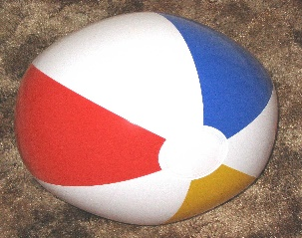
Durham & Chester-Le-Street School Sport Partnership
Infant Agility Cards
Activity Card 4 | Activity Card 5 | Activity Card 6
Catcher | Jumper | Launcher
Equipment needed Spot or marked out area Large ball | Equipment needed Jumping area Starting line Measuring tape or items that can measure the distance covered | Equipment needed 3 cuddly toys Measuring tape Cones
Instructions The child must stand on a spot or in the designated area and complete the following routine with a large ball to receive points. Throw and catch Throw clap catch Throw clap x 2 catch Bounce catch Bounce clap catch Bounce clap x2 catch | Instructions Child stands at the starting line. Make sure toes are right up to the start line. Ask the to child to swing their arms and jump as far forward as they can. Take a measurement from the place where the heel lands. This can be with a measuring tape, coloured pieces of paper, a teddybear or anything else that can measure the distance. Each jumper has 3 attempts. | Instructions The launcher stands behind the throwing line. Standing in a sideways stance throw a teddy bear as far as possible. Record where the teddy bear lands with a cone. Each thrower has 3 attempts.

Slide 3
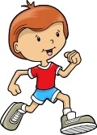
Durham & Chester-Le-Street School Sport Partnership
Infant Agility Cards
Activity Card 7 | Activity Card 8 | Activity Card 9
Pitcher | Runner | You decide
Equipment needed Work station set up with the equipment below 3 coloured hoops or storage boxes 6 matching coloured bean bags or cuddly toys Starting lines made out of rubber lines, skipping rope, belt or a chalk line on the floor | Equipment needed Running lanes made out of coloured cones (must be 5m approximately long). Whistle. 1 stop watch or anything to time the activity | Equipment needed Create your own station with your own equipment.
Instructions Invite child up to the starting line. The pitcher must throw the correct coloured bean bag into the correct coloured hoop or box. If bean bags are not available coloured toys and storage boxes can be used. 1 point per successful throw. | Instructions Invite child up to the running lane. On the whistle the children must run up their lane to the cone at the top, and back down to the starting line. The runner has 30seconds to run as many laps as possible. Each time they go to top of the lane and back they earn a point. | Instructions Over to you. Be a competition designer and create your own event. Challenge your brothers and sisters or your parents and see who is the champion. Points for creativity (max of 3) Points for determination (max of 3) Good luck!!

