Slide 1
We all know the benefits of being physically active . When times are tough and it is difficult to get outdoors, it can be quite tricky to come up with ideas to keep the children occupied and active. With modern technology, there are numerous websites available to support physical activity at home; not just for children, but for the whole family. Most activities only take around 5-30 minutes to complete, so it can fit easily into the day. Here are some ideas and resources we think you might find useful placed in a weekly activity timetable. You can adapt the timetable to suit your own needs! If you have any further activities you recommend, please let us know and we can share them with everyone else.
Nursery & Reception ACTIVE AT HOME
Check out our social media channels and tag us in any of your activities
Facebook - @DurhamClsSSP
https://www.facebook.com/DurhamClsSSP/
Twitter - @DurhamCLS_SSP
https://twitter.com/DurhamCLS_SSP

Slide 2
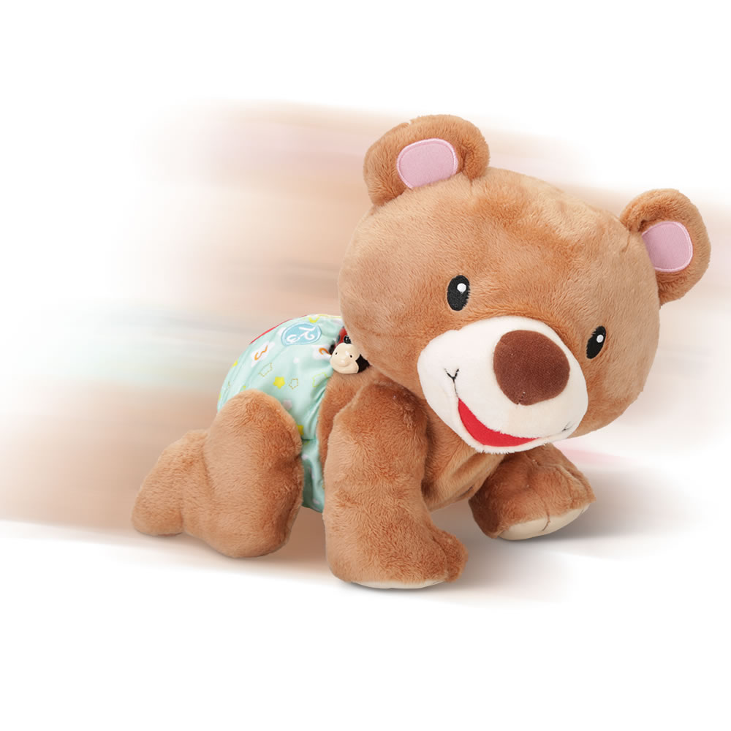
 | MONDAY | TUESDAY | WEDNESDAY | THURSDAY | FRIDAY
PHYSICAL ACTIVITY | Lets get moving We all like to start the week with one of Gemma’s dance routines. Try this one, The Coolest Person. Click here for Video | Treasure hunt Using your shape cards from last week, hide a set of the shapes all over the garden. Then hand your child one card shape and they need to find it and bring it back. Continue the treasure hunt until all of the shape cards have been found. | Obstacle course We did this a few weeks ago but this time it’s got an added twist. Try and complete the obstacle course crawling with a teddy on your back. Remember to make tunnels and bridges out of items in your house and garden. | Yoga time A game to complete our yoga work. Play the happy wiggle game from the card provided. See slide 7 | Zooming time For your last school day see if you can go on a bike / scooter ride with your family. Show everyone how good you have got since you started to learn to ride. Have fun.
SCHOOL GAMES VALUES ACTIVITY | Determination Self Belief Honesty Respect Team Work
CHALLENGE ACTIVITY | Decathalon Competition You have now completed work on 6 of the decathalon activities. Challenge your family to a mini competition using the cards provided. See slides 3&4 | Infant agility - Launcher Last week we did a throw from the chest. This week we are going to look at a longer throw. See slide 5 | Pawsome Panda Play our final Pawsome Panda game with your family or friends. See slide 6 | High knees Competition Last week we kicked our bottoms, this week we are going to take our knees high. How many high knees can you do in 30 seconds? See slide 8 | Competition time Its almost the school holidays so time for your very final challenge. Choose any of the activities we have done over the past 6 weeks and challenge your family. Award Mum, Dad, Gran, Sister, brother or carer a medal at the end of it. Medals attached. See slide 9
All this week you are going to create a big picture showing all the fun activities you have done when thinking about the school games values.
Draw a picture of you working together with your family for team work, or the determination you had for riding your bike.

Slide 3
Durham & Chester-Le-Street School Sport Partnership
mini decathalon challenge especially for Nursery and Reception children.
Activity Card 1 | Activity Card 2 | Activity Card 3
Sprint | Long jump | Shot put
Equipment needed Stop watch or any timer Start line and finish line. | Equipment needed A start line and a measuring tape | Equipment needed A ball that can fit in your hand
Instructions The decathalon has 100 meter sprint. We can have a 10 meter sprint. Mark out the course in the garden. Get ready, set and go ………… Can you beat your Mums / Dads / Brothers or Sisters time? | Instructions Stand with two feet behind the starting line. Swing your arms backwards and forwards and bend your knees a little bit. When you are ready jump forwards as far as you can. Don’t fall over though! Look at how far you jumped…… Is it really far? Have another go and see if you can beat your record. | Instructions Stand at your starting line again but this time stand sideways. Hold the ball in your throwing hand and make a big star shape with your body. Put the ball right next to your neck…. It might feel cold. Lean away from the line and push the ball away from your neck and as far away from the starting line as possible. I bet it flies through the air!!!!

Slide 4
Durham & Chester-Le-Street School Sport Partnership
mini decathalon challenge especially for Nursery and Reception children
Activity Card 4 | Activity Card 5 | Activity Card 6
High Jump | Middle distance run | Hurdles
Equipment needed A skipping rope | Equipment needed Stop watch or any timer Start line and finish line and a track to run around | Equipment needed 5 large teddies A start line and a finish line A stop watch or timer
Instructions This one is a tricky one. We don’t want anyone getting hurt so go very carefully. Ask someone to hold a skipping rope up just off the ground for you and see if you can jump over it. Think of all the ways you can jump. Remember to land on your feet and bend your knees. The athletes who do this in competitions have a soft mat to land on… we are not so lucky. Gradually get higher and higher. | Instructions Set up a course in your safe space…. A back garden, a yard or out on the path if your parents say its safe and they can take you. Jog around the safe space for 2 minutes without stopping. You will feel out of breath and want to give up, but keep going. How many times did you jog around your safe space track? | Instructions Put a teddy out on the grass or floor somewhere that has space. Do three giant steps in a straight line then put another teddy on the ground. Do the same for all five of your teddies. Now see how quickly you can hurdle (jump) over the teddies when you run from the start to the finish line.

Slide 5
Infant Agility Activity Card 6 - Launcher
Launcher
Equipment needed 3 cuddly toys Measuring tape Cones
Instructions The launcher stands behind the throwing line. Standing in a sideways stance throw a teddy bear as far as possible. Record where the teddy bear lands with a cone. Each thrower has 3 attempts.

Slide 7
Yoga Games
The Happy Wiggle game
Children love and need to move their bodies. In order to develop a strong balance system, children need to move their body in all directions, for hours at a time. This game gives them a chance to do just that.
Explain to the children that when you shout ‘Wiggle’ the children can wiggle their bodies in every direction. Up, down, side ways, wiggle arms, legs, fingers.
Then after a few seconds shout out one of the yoga poses from the poster or your own yoga poses that you have created with your children and ask all the children to do the pose.

Slide 9
Cut out and keep the medal you won.

