Slide 1
We all know the benefits of being physically active . When times are tough and it is difficult to get outdoors, it can be quite tricky to come up with ideas to keep the children occupied and active. With modern technology, there are numerous websites available to support physical activity at home; not just for children, but for the whole family. Most activities only take around 5-30 minutes to complete, so it can fit easily into the day. Here are some ideas and resources we think you might find useful placed in a weekly activity timetable. You can adapt the timetable to suit your own needs! If you have any further activities you recommend, please let us know and we can share them with everyone else.
Nursery & Reception ACTIVE AT HOME
Check out our social media channels and tag us in any of your activities
Facebook - @DurhamClsSSP
https://www.facebook.com/DurhamClsSSP/
Twitter - @DurhamCLS_SSP
https://twitter.com/DurhamCLS_SSP

Slide 2
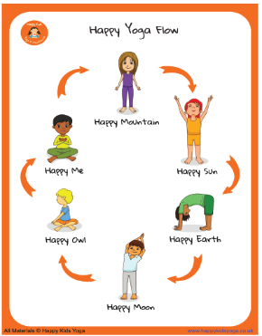
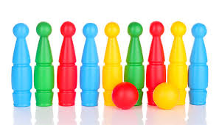
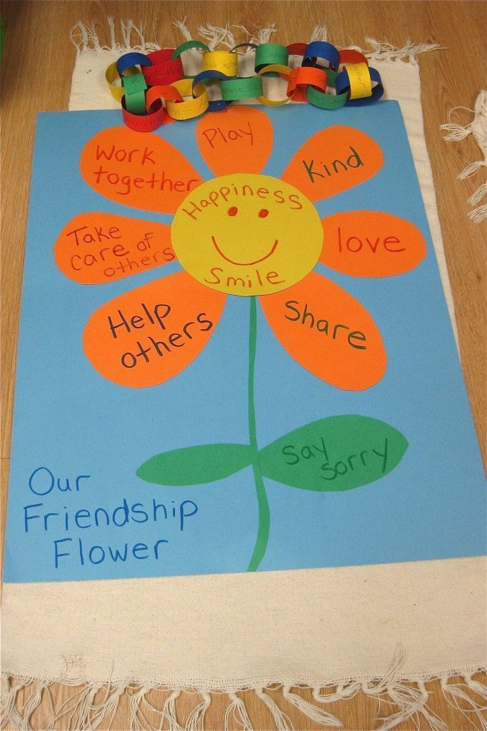
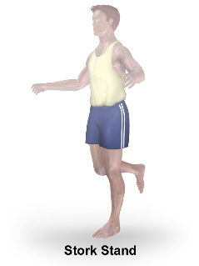
 | MONDAY | TUESDAY | WEDNESDAY | THURSDAY | FRIDAY
PHYSICAL ACTIVITY | Lets get moving Start the week by joining in with one of our dance routines. Follow SSP Coach Gemma Smith’s Hot Hot Hot dance routine and lets try and get the sun to shine again. Click here for Video | Yoga time Our specialist PE teacher Marie Claire Lowrey has written a wonderful yoga scheme especially for early years. Try some of the fun poses shown on slides 4 & 5 | Skittles Back to a game we played in week one (see slide 7) but this time with an added challenge. First attempt put the skittles in the traditional triangle shape. Next time place them in a line. Third time put them in a square and finally set them out in a wiggle snake pattern. Who is the champion for each of the shapes? | Dance star Use pictures of animals and items from your favourite story book to explore body shape, balance and movement: Examples below could help you start. Tree – stretch Bee – fly and swoop Kangaroo – jump/pounce Bear – wide Flea – small quick jumps Move from one movement to another. Change the order of the pictures around. | Zooming time Go on a mini journey on your bike or scooter today. Green means go, red means stop, amber means stamp your feet up and down getting warmed up. Other things parents could shout out are roundabouts, encouraging the children to balance whilst going around in a circle. Traffic jam allows slow movements or even balancing whilst stopping. Roadworks could involve going in and out of cones.
SCHOOL GAMES VALUES ACTIVITY | Determination Set yourself a challenge to run, skip, jump, dance or walk further than you have done before. It might be around the garden 10 times, or around the field with your family. | Self Belief Get a really tricky puzzle or jigsaw out of your play area. Choose one that you have not been able to do on your own before. Now is the time to do it. You can do it!! Believe in yourself. | Honesty Watch the you tube clip Trust in me from Jungle book and talk about if you think the snake is being honest and telling the truth? Click here | Respect When you respect someone you do nice things for them. Draw a lovely friendship flower and every time you do something nice write it on the petals. | Team Work Working together as a team create a picture in your house or garden. You can use teddies, bean bags socks or anything that’s available. See our example Sad Sam on the Funny faces card. Shown on slide 9
CHALLENGE ACTIVITY | Try the Decathlon Throwing Challenge shown in slide 3. Try this new challenge. The shot put is a different way of throwing a ball. I bet you can throw it a really long way. | Try out Activity card 4 from our Infant agility competition Balancer. See slide 6 | The Skipping – Rope Snake Developing gross motor skills Jump the River – lay 2 ropes on floor to make a river with a narrow end and a wide end. Practice jumping 2 feet to 2 feet over river. Practice the following jumping patterns: 2-2, 2-1, 1-2, 1- same one, 1- other one | Pawsome Panda – Throw and Follow game – see slide 8 Play the throwing and kicking game with your family, just like Pawsome Panda | Competition time Set up all of the challenge activities you have tried this week and have a family competition. Award a prize at the end of the competition for the best performance, but also have a prize for the most improved or the best effort.

Slide 3
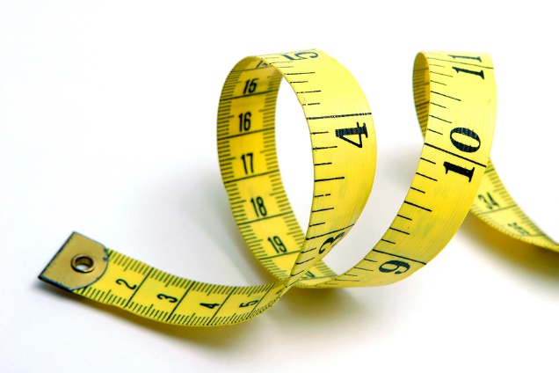
Decathalon Card 3 - Shot Put
Equipment needed A ball that can fit in your hand
Instructions Stand at your starting line again but this time stand sideways. Hold the ball in your throwing hand and make a big star shape with your body. Put the ball right next to your neck…. It might feel cold. Lean away from the line and push the ball away from your neck and as far away from the starting line as possible. I bet it flies through the air!!!!

Slide 4
Activity 1
Happy Yoga Flow
This activity can be done at any point in a standing or sitting position. It can be done at any point during the day, but morning’s are recommended to start the day.
This activity stretches the back in every direction and lets kids' bodies stay supple, strong and flexible. At the end of the flow we stop, close our eyes and think of something we are grateful for.

Slide 5
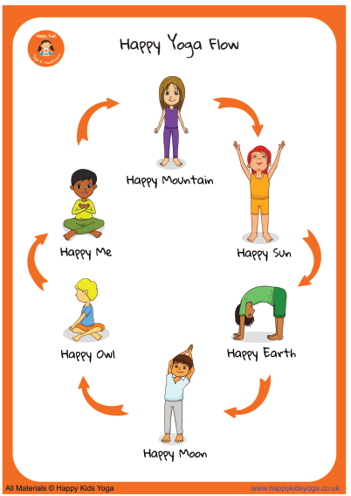
Happy Mountain
We start in Mountain pose, still and quiet.
Benefits - Improves posture by strengthening the thighs, knees and ankles and by firming the abdomen and buttocks. Can also be beneficial for flat feet.
Happy Sun (Stretch up)
Stretch your arms up above your head, look up at your hands and say hello to the sun.
Benefits - strengthens the spine, opens the chest and increases blood flow to the frontal lobe for improved comprehension and rational thinking.
Happy Earth (Forward Bend)
We reach down to our toes and say hello to the Earth. Slowly roll your body back up.
Benefits - helps to release tensions in the neck, shoulders, lower back, or hips that are caused due to long hours of desk work. Calms the brain, reducing tiredness and irritability. Happy Moon (Side Bends)
Sit or stand tall with your legs together and bend over to one side, looking a bit like a moon or maybe a banana. Come back to the middle and repeat on the other side.
Benefits - Good for stretching the spine and helping you grow tall.
Happy Owl (Seated Twists)
Sit tall, one hand to knee, other hand helps you to twist. Look over your shoulder with a twit twoo. Repeat on the other side.
Benefits - stretches the hips, neck and arms. It increases flexibility throughout the spine, shoulders and chest. It also helps to reduce stress and anxiety.
Happy Me (Easy Pose)
Bringing your hands together at your heart, tap your fingers right then left, close your eyes.
Think of something you are grateful for in your life.
Benefits - Stretches out the groin, strengthens the back and also allows for deep belly breathing.

Slide 6
Durham & Chester-Le-Street School Sport Partnership
Infant Agility Cards
Activity Card 4
Balancer
Equipment needed 1 stop watch or anything to time the activity 1 spot
Instructions Put a rubber spot on the floor. If you do not have a rubber spot you can make a spot using a cereal box. Children then must balance on one leg for as long as they can. Time the child to give them a score. Maximum time a child can achieve is 15 seconds. 2 attempts on each leg, 4 attempts in total.

Slide 7
 | Physical activity Skittles
Save up your empty juice, milk or pop bottles for this game. Line the bottles up and encourage the children to roll a ball and see how many they can hit down. The bottles can be arranged in any pattern as long as they are behind the line. This would be a good investigation activity for the children to do too, when deciding if they should be in a straight line, a triangle a square etc.

Slide 9
